Slide 1
Countries Clustering
By:- Amit Chawla

Slide 2
Objective -
Grouping of countries based on socio-economic factors and identify the countries in need of Aid.

Slide 3
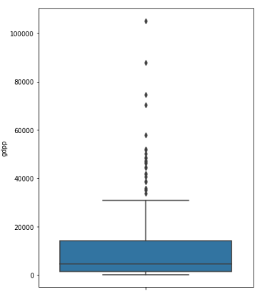
GDP of the countries
We have GDP as low as 231 and as high as 10500.
Countries on higher end of the plot might not be very useful for our purpose.

Slide 4
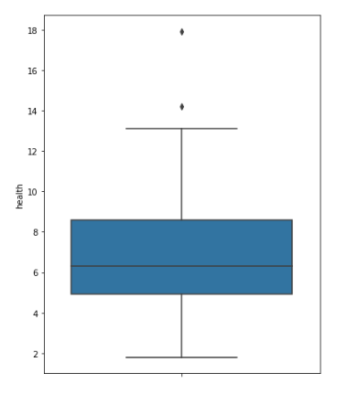
Expenditure on health as %age of GDP.
Countries like US spend 18% of their GDP on public health infrastructure.
Countries like Mynamar, Pakistan spend
Less than 3% of GDP on health infrastructure.

Slide 5
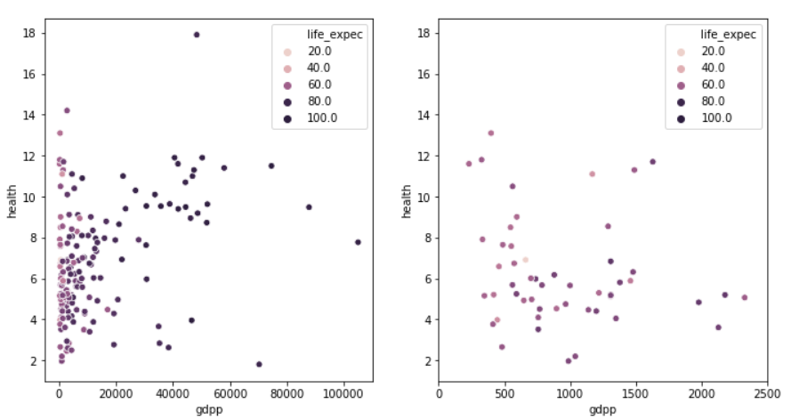
Life expectancy, GDP, and Health Spending
Countries with low GDP and low spending on health infrastructure have life expectancy.
Life expectancy is low in countries with less GDP even in cases where spending on health is high

Slide 6
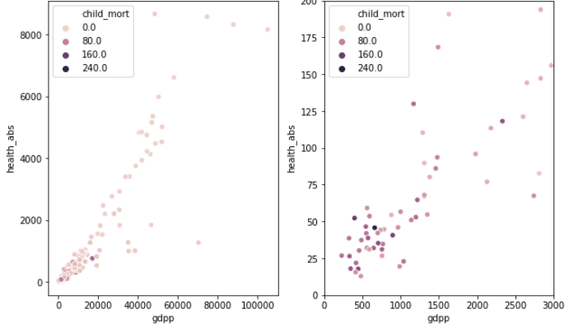
Child mortality, health spending and GDP
Countries with low gpd and less spending on the health infrastructure have high child mortality rate.

Slide 7
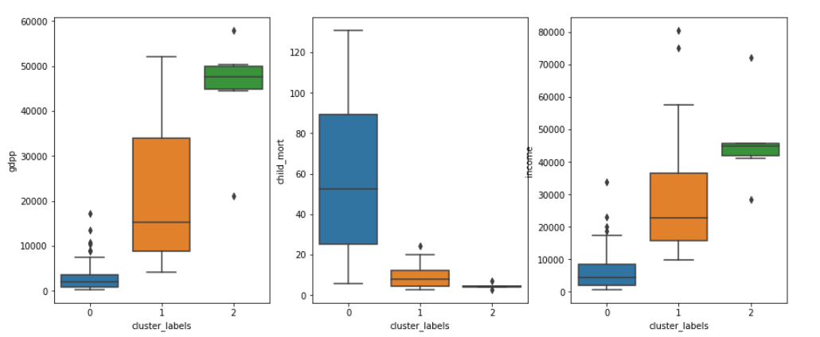
Hierarchical Clustering
Among the 3 clusters, first group has lowest GDP, highest median and mean child mortality rate and lowest income.

Slide 8
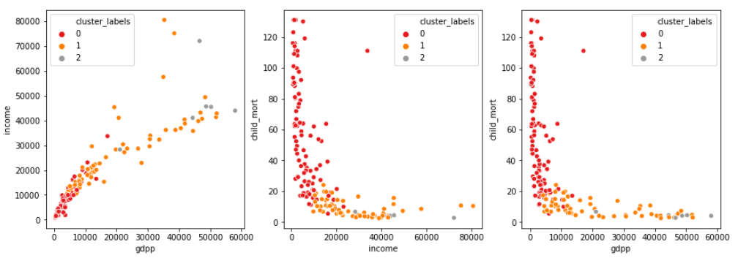
Hierarchical Clustering
Observations from previous graph are ascertained by the above plots of income, GDP and child mortality for all the 3 clusters.

Slide 9
Top 5 Countries for Aid(Hierarchical Clustering)
Sorted by GDP(asc), income(asc), child mortality(desc)
Burundi
Liberia
Congo Dem. Rep.
Niger,
Sierra Lenonne
Sorted by GDP(asc), income(asc), child mortality(desc)
Central African Republic
Sierra Lenonne
Haiti
Mali,
Chad

Slide 10
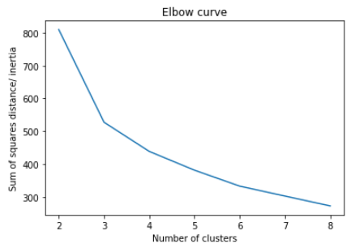
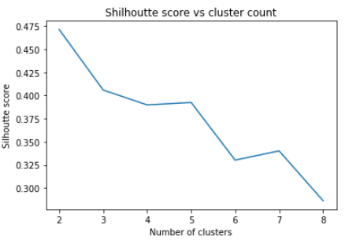
K-Means Clustering
We can confirm that 3 will be a good number of clusters for given data.

Slide 11
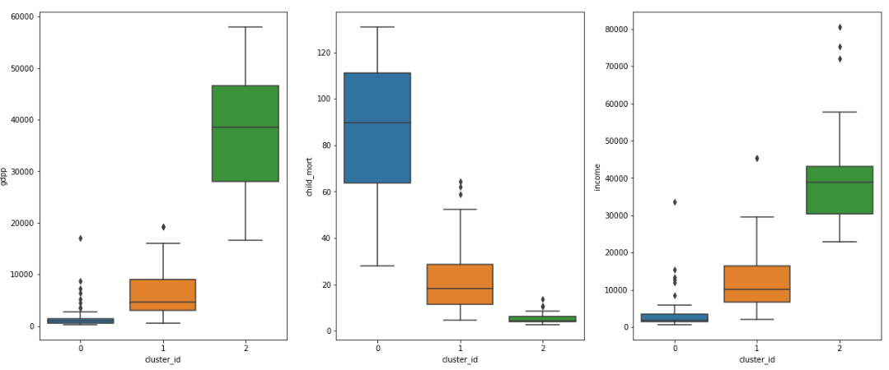
K-Means Clustering
Among the 3 clusters, first group has lowest GDP, highest median and mean child mortality rate and lowest income.

Slide 12
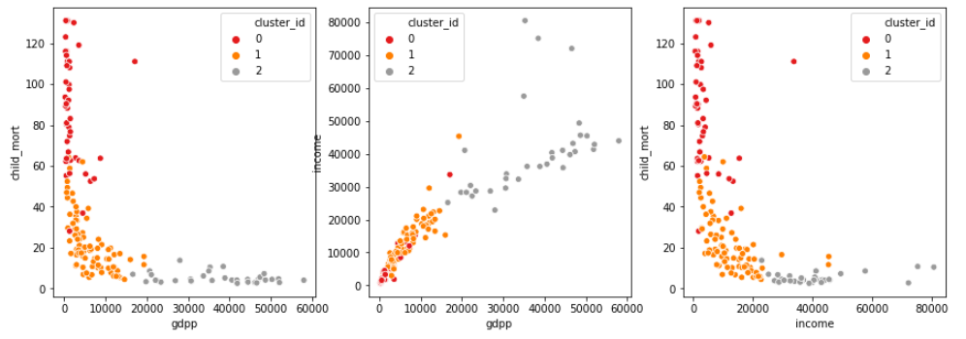
K-Means Clustering
Observations from previous graph are ascertained by the above plots of income, GDP and child mortality for all the 3 clusters.

Slide 13
Top 5 Countries for Aid(K-Means Clustering)
Sorted by GDP(asc), income(asc), child mortality(desc)
Burundi
Liberia
Congo Dem. Rep.
Niger,
Sierra Lenonne
Sorted by GDP(asc), income(asc), child mortality(desc)
Central African Republic
Sierra Lenonne
Haiti
Mali,
Chad

Slide 14
Final Recommendations
We note that both our algorithms returned same set of countries.
All these countries are African countries.
Based on the priority of the organization final countries can be chosen from the above 2 sets.
If the priority is health and child mortality group 2 countries can be selected.
If the priority is country’s economy group 1 can be selected.
Countries – Central African Republic, Sierra Leonne make into top 10 of both the sets. Hence can be considered as priority.

